Slide 1
IT as a Utility (ITaaU) A Digital Economy Challenge Area Jeremy Frey, Steve Brewer (University of Southampton)
OGF40 – FedSec-WG
16 January 2014

Slide 2
Introduction
IT as a Utility Network+
1 of 4 networks supported by RCUK Digital Economy Theme
Aim: better understanding the benefits and opportunities afforded by the digital economy
Objective: foster collaboration between academia, business and policy-making bodies

Slide 3

IT as a Utility
funded under Research Council UK's Digital Economy theme
The Digital Economy vision is of the transformational impact of digital technologies on all aspects of life.

Slide 4





Introduction: partners & collaborators
PI and Co-Is:
Jeremy Frey ( Southampton)
Gerard Parr (Ulster)
Mark Sandler (QMUL)
Richard Mortier ( Nottingham)
Mike Surridge (Southampton)
Advisory group:
ustwo
IBM
BT
Thales
Microsoft
BBC Reseaerch
Cabinet Office
DSTL
Zenotech
Cambridge & Newcastle Universities
Steve Brewer – Network Coordinator

Slide 5


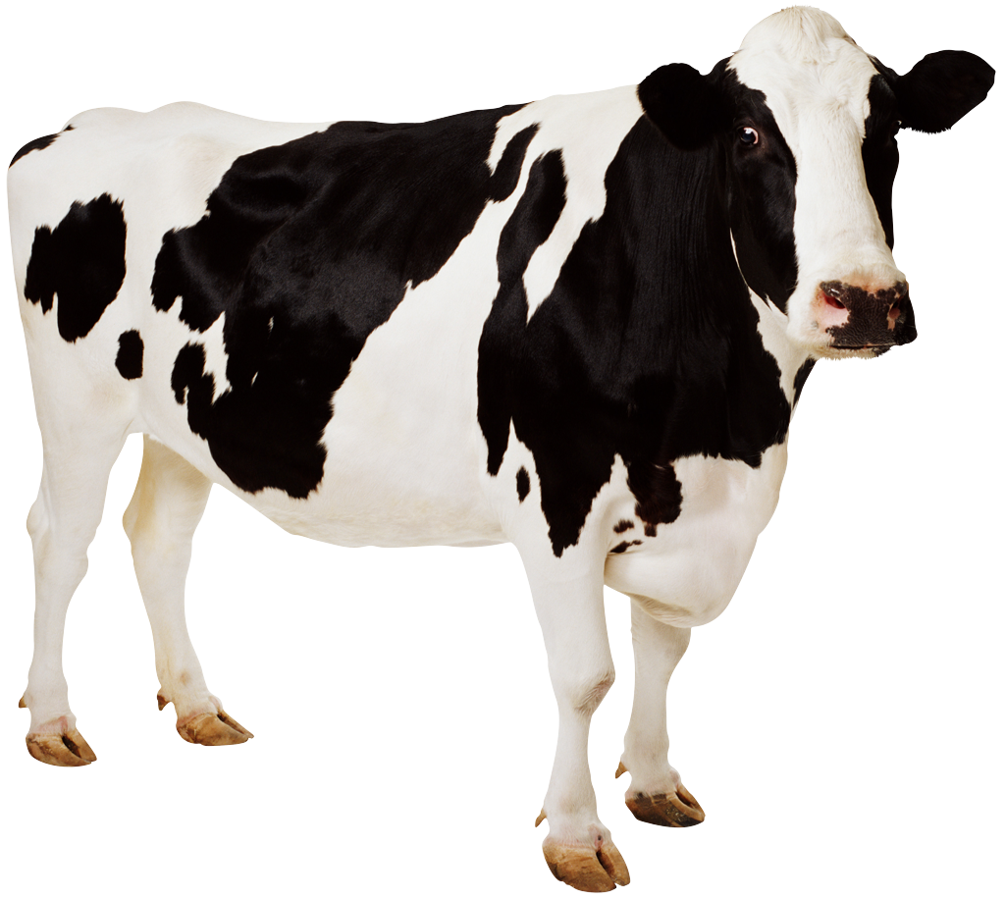
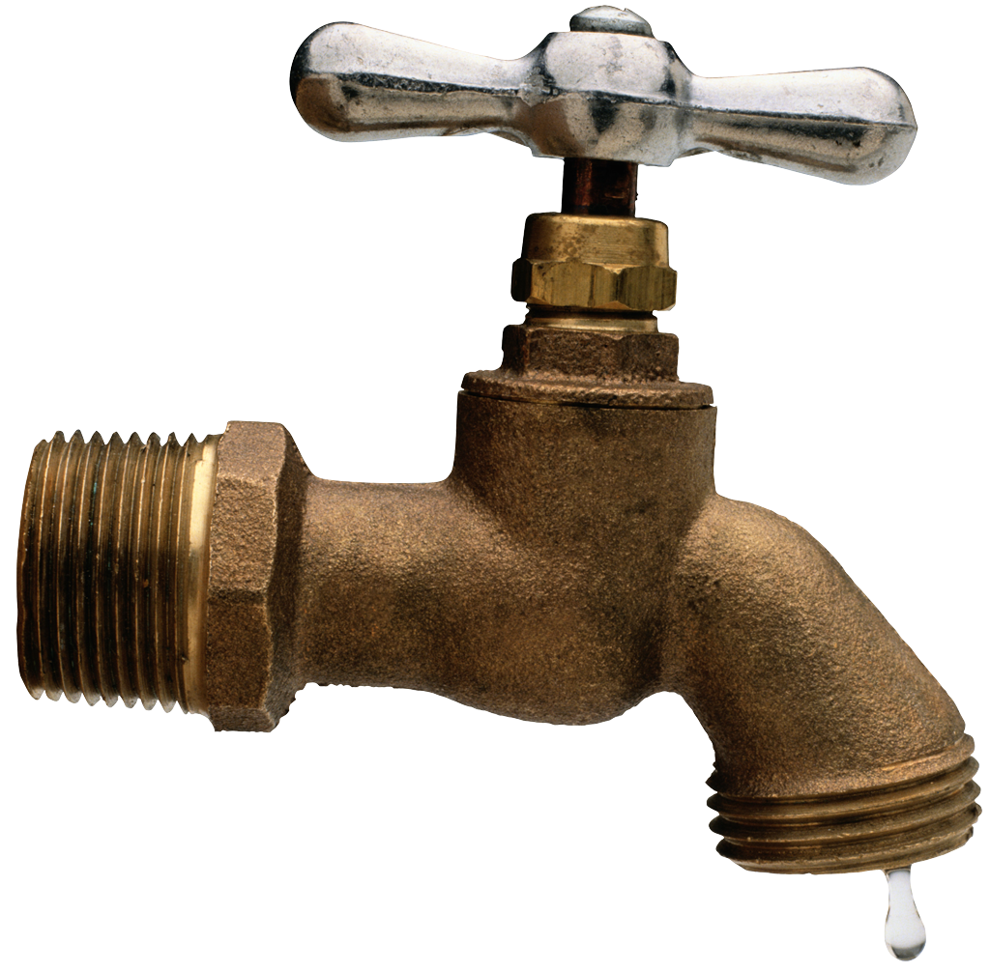
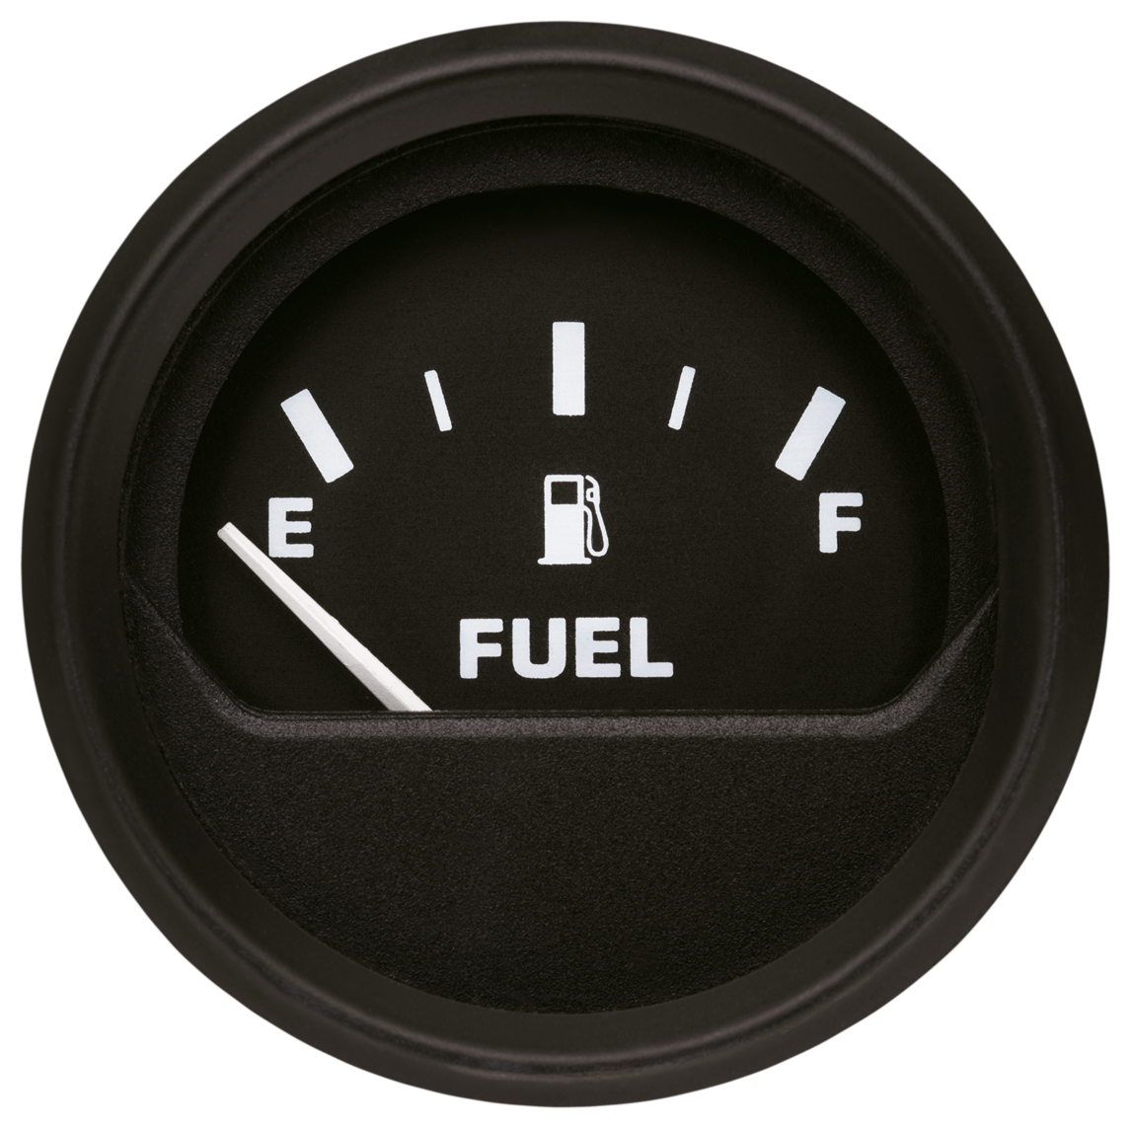

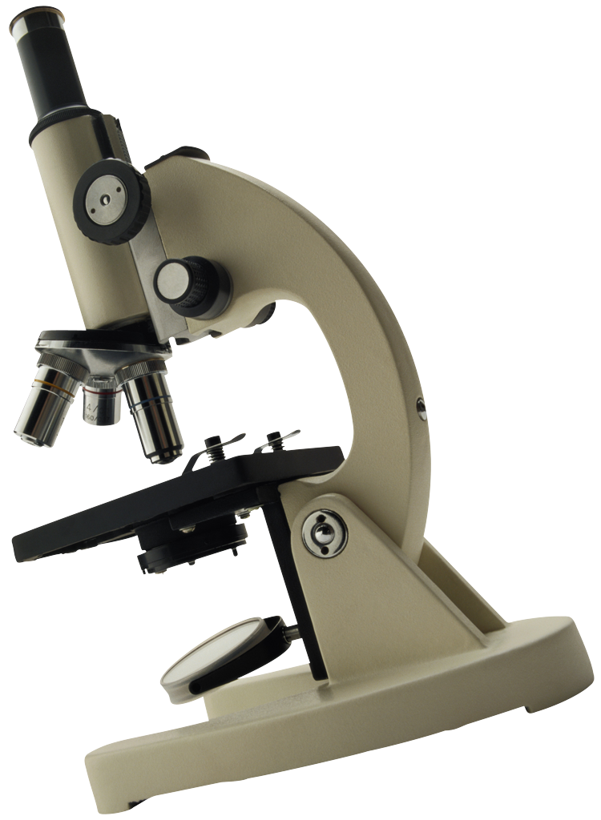
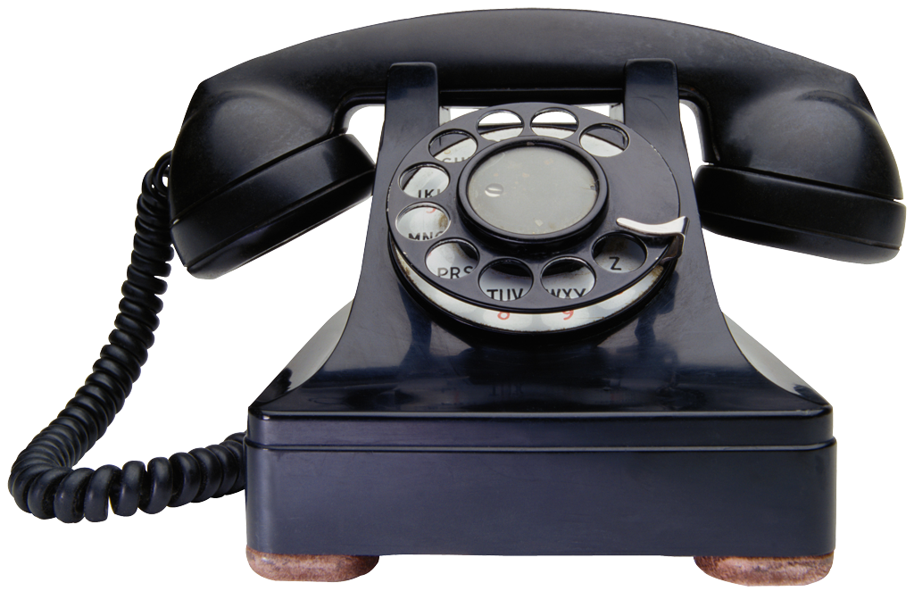
The Digital Economy and ITaaU
The Cloud
3D printing
“Network+ smart spaces/
smart cities”
cloud computing
food security
traditional
utilities
The Digital Economy
“apps are the
new taps…”
sensors &
actuators
“tangible
Interfaces”
libraries of
the future
data-driven
science
electronic lab
notebooks
telecommunications

Slide 6
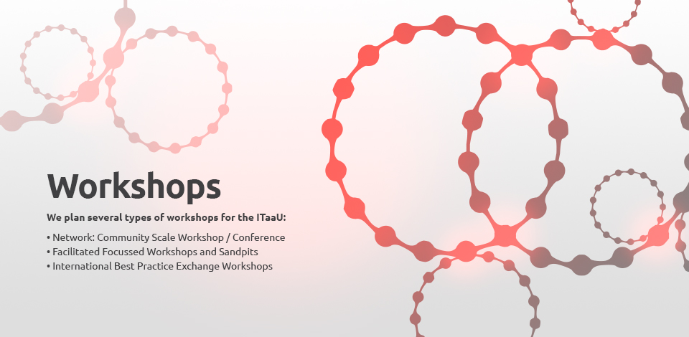
Workshop themes have included:
libraries of the future
emerging economies,
user interaction design
trust and security
Food Security
Smart Environments
Diversity

Slide 7

First two successful pilot projects have now been running for a while:
Trusted Tiny Things – led from University of Aberdeen
Using Wireless Networks to Support First Responders and Resilience in Upland Areas – led from QMUL & Cambridge

Slide 8
Pilot Projects about to start
Typology of Loss in Vaccine Supply (TOLIVS)
Deploy pilot cloud service/mobile sensing in the field for vaccine tracking. Particularly typology of loss in the cold supply chain
CloudMaker
A utility to support social creativity between children
BluPoint
Provision of digital content as a utility in low-resourced off-grid communities
Sun & Sky
A sun and sky environmental monitoring system for crowd sourcing
Communities in the Cloud
Technology to support high-density/high/rise communities

Slide 9

Call 2 has recently closed
“a temporary transfer to a new research environment”
opportunities for career development, sectoral knowledge transfer and access to short term skills for project development

Slide 10
Secondment Projects being arranged
Exploring social knowledge integration with digital mapping technologies to benefit communities
Integration of IoT and M2M technologies for the weightless network. Investigation of challenging propagation environments. Workshop planned.
Social pedestrian modelling of Clapham Junction and London Bridge Station.
Film - Story as Utility: “The social life of data”

Slide 11
Where does this lead us?
Data lies at the heart of the digital economy
This has many implications for the future
Big data
huge quantities of homogenous, heterogeneous and disparate – new mathematics needed
Security and trust issues will pervade
Design matters – democratization of data and its by products: information and knowledge

Slide 12
Data as a commodity…
…on which IT utilities aim to prosper.
commodity, n.
The quality of being ‘commodious’; conveniency, suitability, fitting utility; commodiousness. Obs.
Etymology: < French commodité (15th cent. in Littré), < Latin commoditāt-em due measure, fitness, convenience, complaisance, < commodus
“The concrete senses appear to have arisen in the modern languages”

Slide 13
Design as an Ideal
User centred Design
More workshops planned including for projects
Ensemble Design
Design by ensembles; design for ensembles
Smart environments
M2M interaction integrated with user interaction
Support for Diversity
Deeper integration of diverse user needs will benefit all; all users have individual needs. Personalisation matters but is challenging.

Slide 14
Users as a Focus
Digital Economy multidisciplinary and integrated approach to complement ICT research

Slide 15
ITaaU and security
In addition to data and design, security together with trust has emerged as a key pervading theme
ITaaU is promoting projects and secondments that are significantly concerned with security
Security in the Food Chain: role of IT?
The National Archive: decisions about what needs to be secure?
Interface design: how to communicate security?
Standards matter: need to be applied, verified and understood by users and providers

Slide 16
ITaaU: Trust and Security
2-day workshop held on 21-22 Nov 2013
Shenja van der Graaf from iMinds in Belgium
Tim Gollins from the National Archive
Andrew Martin, Trusted Infrastructure, Oxford
Key topics that emerged and were discussed:
Hazard and risk – how to measure & quantify?
Culture – context matters, affects responses
Predisposition – modelling risk propensity profile

Slide 17
ITaaU: future plans for security
Continued support for National Archive project
Working with Food Standards Agency to help understand how data sets can interact and other better utilised.
Further collaboration with iMinds looking at cultural attitudes across larger area
Brochure: advising organisations on who they need to bring together to address
Further research into Personal Propensity Profile for risk – how to develop a viable model capturing all facets of trust and security?

Slide 18
Join the ITaaU Network+
Web: www.itutility.ac.uk
Mailing list: http://jiscmail.ac.uk/itutility
Hashtag #itaaun
Twitter: SteveITaaU
Facebook page: http://www.facebook.com/ITutilityNetwork
Email: info@itutility.ac.uk
LinkedIn group: IT-as-Utility-Network

